Slide 1



INSTITUTE: UIE (AIT-CSE)
CSS21: B.E. CSE (H) with specialization in Artificial Intelligence & Machine Learning
Advanced Machine Learning (20CSF-349)
Chapter 1.2: Logistic Regression
Lecture 11: Model Evaluation
By: Mr. Siddharth Kumar
DISCOVER . LEARN . EMPOWER

Slide 2
Advanced Machine Learning
Course Outcome
CO | Title
1 | Have a good understanding of the fundamental issues and challenges of machine learning: data, model selection, model complexity, etc.
2 | Appreciate the underlying mathematical relationships within and across Machine Learning algorithms and the paradigms of supervised and un-supervised learning
3 | Design and implement various machine learning algorithms in a range of real-world applications.
4 | Design and evaluate intelligent expert models for perception and prediction using machine learning algorithms
5 | Analyze and make use of machine learning algorithms-based applications using performance

Slide 3
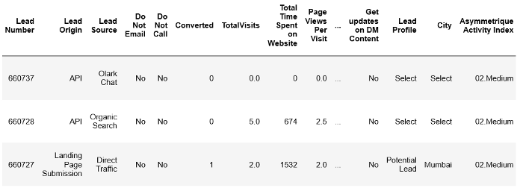
Problem Statement
To understand the working of regression-based model, we consider a problem statement from an online education platform where we look at factors that help us select the most promising leads, i.e. the leads that are most likely to convert into paying customers.
Data Cleaning & Preparation: Once you load the necessary libraries and the dataset, let’s have a look at the first few entries using the head() command.

Slide 4
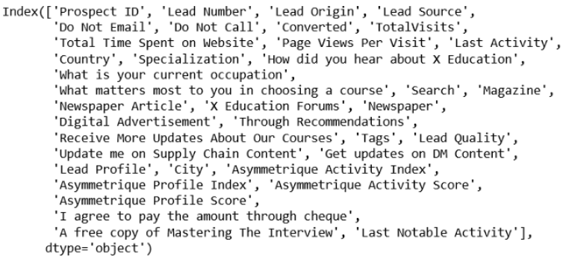
The shape commands tells us the dataset has a total of 9240 data points and 37 columns. Below listed are the name of the columns present in this dataset:

Slide 5
As you can see, most of the feature variables listed are quite intuitive. Please refer to the data dictionary to understand them better.
Further analysis reveals the presence of categorical variables in the dataset for which we would need to create dummy variables. Before that, we treat the dataset to remove null value columns and rows and variables that we think won’t be necessary for this analysis (eg, city, country) A quick check for the percentage of retained rows tells us that 69% of the rows have been retained which seems good enough.
Test-Train Split: The target variable for this dataset is ‘Converted’ which tells us if a past lead was converted or not, wherein 1 means it was converted and 0 means it wasn’t converted. Import the test-train-split library and make a 70% train and 30% test split on the dataset.
Few numeric variables in the dataset have different scales, so scale these variables using the MinMax scaler. The variables will be scaled in such a way that all the values will lie between zero and one using the maximum and the minimum values in the data.

Slide 6
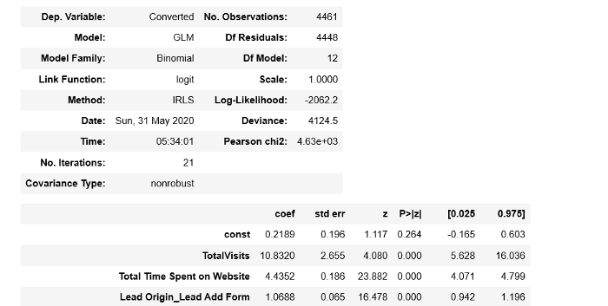
Model Building: Moving on to the model building part, we see there are a lot of variables in this dataset that we cannot deal with. Hence, we’ll use RFE to select a small set of features from this pool.
We’ll now use statsmodels to create a logistic regression models based on p-values and VIFs. To begin with we’ll create a model on the train set after adding a constant and output the summary. This is how the generalized model regression results would look like:

Slide 7
We’ll also compute the VIFs of all features in a similar fashion and drop variables with a high p-value and a high VIF.
After re-fitting the model with the new set of features, we’ll once again check for the range in which the p-values and VIFs lie. If appropriate, we’ll proceed with model evaluation as the next step.
Model Evaluation: We’ll now predict the probabilities on the train set and create a new data-frame containing the actual conversion flag and the probabilities predicted by the model.
Add a column to capture the predicted values with a condition of being equal to 1 (in case value for paid probability is greater than 0.5) or else 0.

Slide 8
You are now familiar with the basics of building and evaluating logistic regression models using Python. Generally, it is a straightforward approach:
(i) Import the necessary packages and libraries
(ii) Data cleaning, transformation
(iii) Classification model to be created and trained with the existing data
(iv) Evaluate and check for model performance
(v) Make predictions on the test sets

Slide 9
References
T1: Mitchell T.M., Machine Learning, McGraw Hill (1997).
T2: Andreas C. Miller, Sarah Guido, Introduction to Machine Learning with Python, O’REILLY (2001).
Notes:
Introduction to Cyber Security (simplilearn.com)

Slide 10

THANK YOU

